Slide 1

Estimating & Removing Seasonal Variation
Dr. Abolfazl Saghafi
Assistant Professor of Statistics & Data Science
Notes:
We continue this week by discussing ways to remove seasonal variation from non-stationary time series

Slide 2
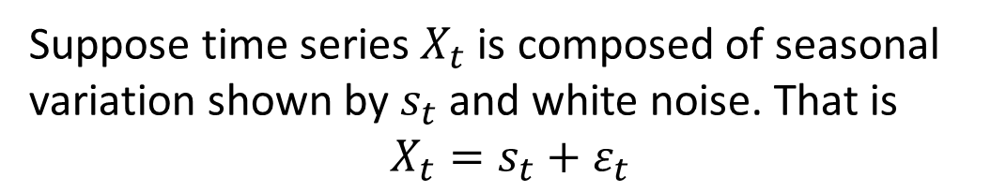
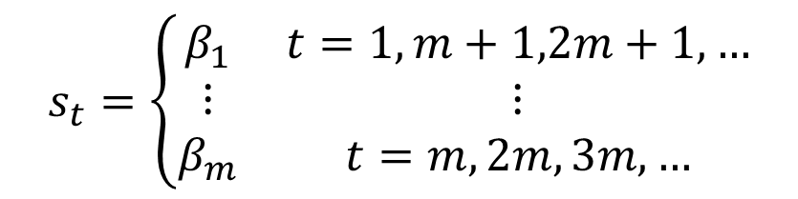

Seasonal Variation
Summary:
● Frequency of cycles is estimated by dividing the series length to number of full cycles
● We assume a constant intercept for the time series in each frequency
● Seasonal variation could exist along with trend, each can be estimated separately or altogether
Suppose time series $X_{t}$ is composed of seasonal variation shown by $s_{t}$ and white noise. That is
$$X_{t}=s_{t}+ε_{t}$$
The frequency of seasonal variation is estimated by dividing the total length of the series by number of full cycles.
Suppose the frequency is m, the seasonal effect is then formulated as
$s_{t}=s_{t+m}$ $∀t$
where
This means that there is an intercept to be estimated for each level of the cycle.
$$s_{t}=\left\{\begin{matrix}β_{1} & t=1,m+1,2m+1,… \\ ⋮ & ⋮ \\ β_{m} & t=m,2m, 3m,…\end{matrix}\right.$$
Notes:
We are assuming that for each season there is a possibly different intercept. If there is an upward trend along with seasonal variation, the trend is better to be estimated first. Although we can assume a linear or more complex models for each season, this increases the number of parameters to be estimated and thus is not preferred.

Slide 3
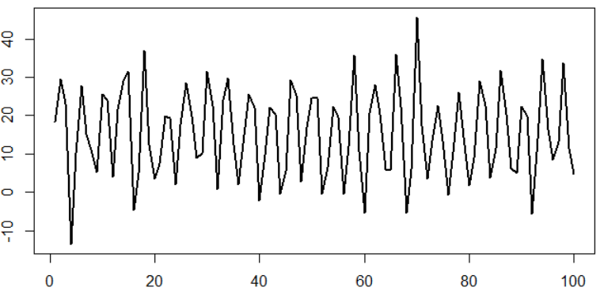
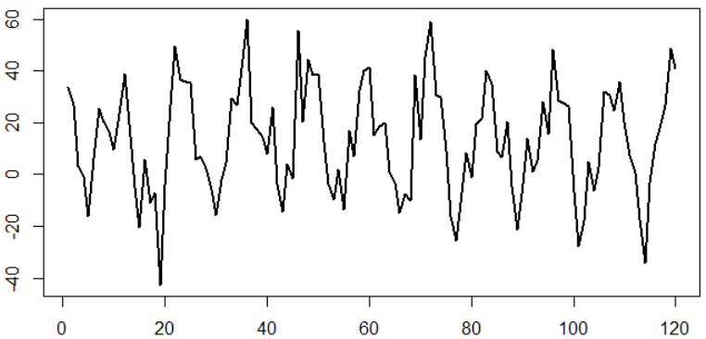

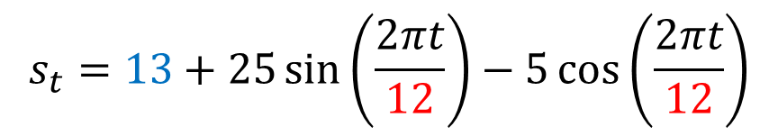





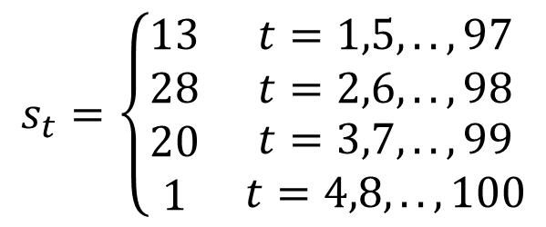

m=4
$$X_{t}=s_{t}+ε_{t}$$
$$t=1,2,…,100$$
$$ε_{t} \sim ^{i.i.d} N\left(0, 5\right)$$
$$s_{t}=\left\{\begin{matrix}13 & t=1,5,..,97 \\ 28 & t=2,6,..,98 \\ \begin{matrix}20 \\ 1\end{matrix} & \begin{matrix}t=3,7,..,99 \\ t=4,8,..,100\end{matrix}\end{matrix}\right.$$
$$s_{t}=s_{t+4}$$
$$X_{t}=s_{t}+ε_{t}$$
$$t=1,2,…,120$$
$$ε_{t} \sim ^{i.i.d} N\left(0, 12\right)$$
$$s_{t}=13+25\sin\left(\frac{2πt}{12}\right)−5\cos\left(\frac{2πt}{12}\right)$$
Notes:
In the first example, we obviously have a cyclic pattern thus the time series is non-stationary and includes a seasonal variations component. To estimate the frequency of cyclic pattern, we count the number of full cycles. Here we have 25 full cycles. Dividing the length of the time series by 25, that is four give us the frequency of the cycles. The given expression is used to generate this seasonal variation and as you can see, we have four constants here.
Another non-stationary times series due to existing seasonal variation. We have 10 full cycles here, so frequency of seasonal variation is 12. We have used a different methods to simulate this time series, the formula is given, as you can see it utilizes a sin and cosine function which makes sense since sin and cosine generate cyclic patterns. You can also see 12 there, that’s what I’ve used for frequency, so we did a good job estimating that.

Slide 4
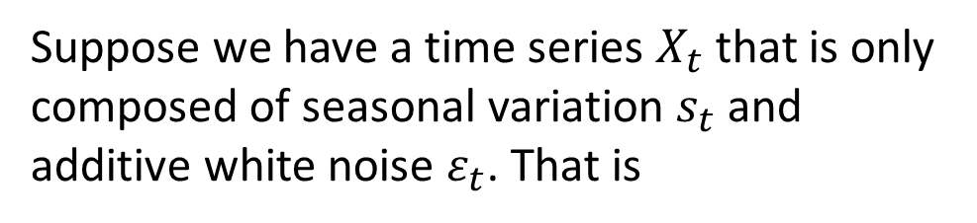
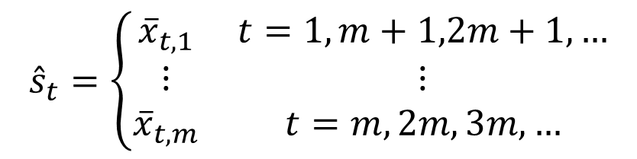

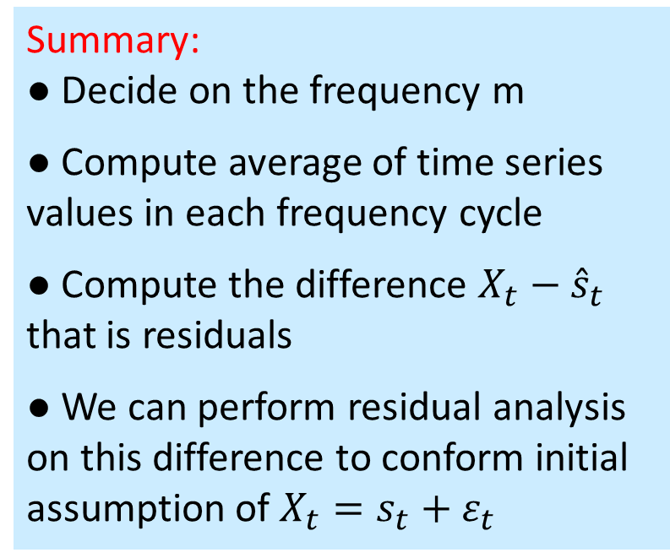

1. Estimating Seasonal Variation
Summary:
● Decide on the frequency m
● Compute average of time series values in each frequency cycle
● Compute the difference $X_{t}−{\hat{s}}_{t}$ that is residuals
● We can perform residual analysis on this difference to conform initial assumption of $X_{t}=s_{t}+ε_{t}$
Suppose we have a time series $X_{t}$ that is only composed of seasonal variation $s_{t}$ and additive white noise $ε_{t}$. That is
$$X_{t}=s_{t}+ε_{t}$$
$$s_{t}=s_{t+m}$$
(i) m is estimated by visual inspection of the time plot.
(ii) Assuming that seasonal variation is composed of constant intercepts for each frequency, these constants can be easily estimated by averaging values for each season. That is
$${\hat{s}}_{t}=\left\{\begin{matrix}{\overline{x}}_{t,1} & t=1,m+1,2m+1,… \\ ⋮ & ⋮ \\ {\overline{x}}_{t,m} & t=m,2m, 3m,…\end{matrix}\right.$$

Slide 5
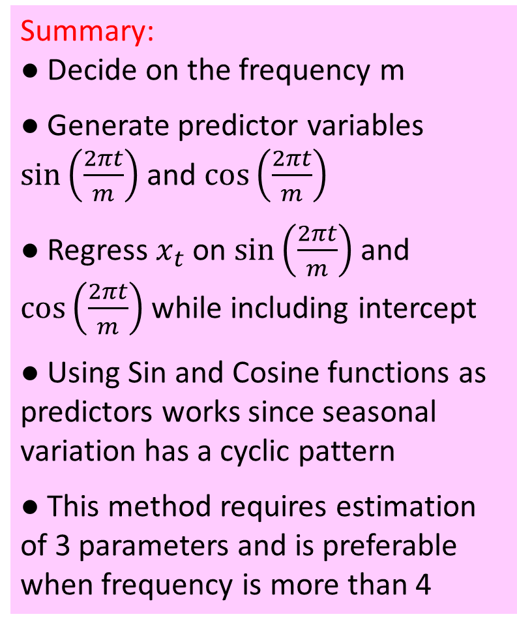
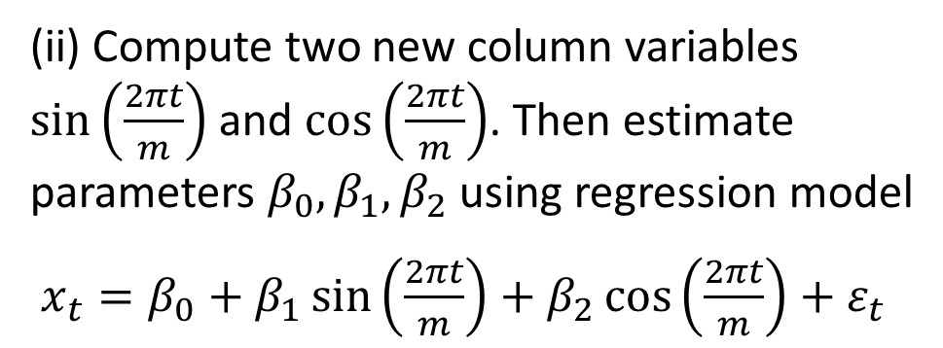
2. Estimating Seasonal Variation
Summary:
● Decide on the frequency m
● Generate predictor variables $\sin\left(\frac{2πt}{m}\right)$ and $\cos\left(\frac{2πt}{m}\right)$
● Regress $x_{t}$ on $\sin\left(\frac{2πt}{m}\right)$ and $\cos\left(\frac{2πt}{m}\right)$ while including intercept
● Using Sin and Cosine functions as predictors works since seasonal variation has a cyclic pattern
● This method requires estimation of 3 parameters and is preferable when frequency is more than 4
There is a second way to estimate seasonal variation that requires regression and is preferred when frequency is more than 4.
$$X_{t}=s_{t}+ε_{t}$$
$$s_{t}=s_{t+m}$$
(i) m is estimated by visual inspection of the time plot.
(ii) Compute two new column variables $\sin\left(\frac{2πt}{m}\right)$ and $\cos\left(\frac{2πt}{m}\right)$. Then estimate parameters $β_{0},β_{1},β_{2}$ using regression model
$x_{t}=β_{0}+β_{1}\sin\left(\frac{2πt}{m}\right)+β_{2}\cos\left(\frac{2πt}{m}\right)+ε_{t}$
Notes:
β₀
β

Slide 6
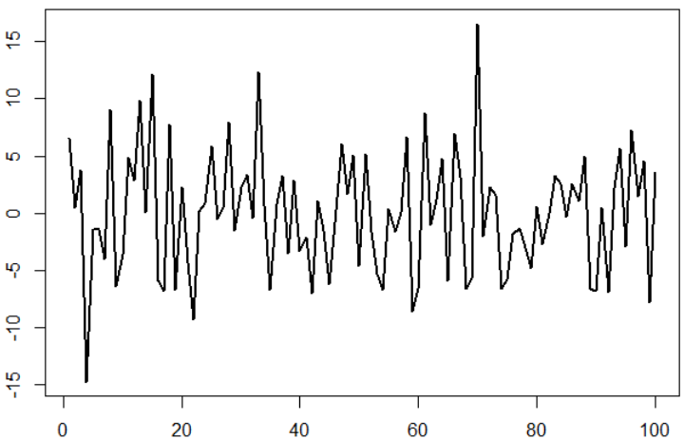


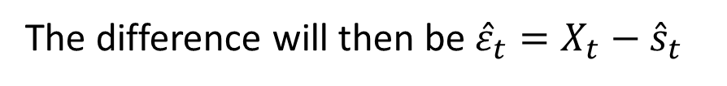
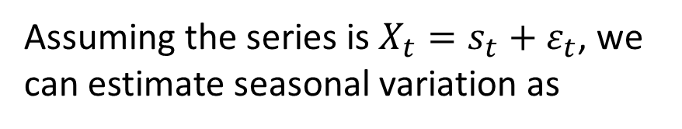
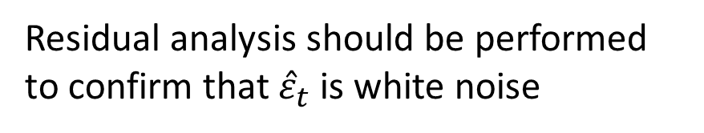
Example
The simulated time series $X_{t}$ is given.
It is obviously non-stationary with seasonal variation, frequency is 100/25
Assuming the series is $X_{t}=s_{t}+ε_{t}$, we can estimate seasonal variation as
$${\hat{s}}_{t}=\left(11.77, 29.14, 19.28, 1.17\right)$$
The difference will then be ${\hat{ε}}_{t}=X_{t}−{\hat{s}}_{t}$
$$\hat{σ}=5.39$$
Residual analysis should be performed to confirm that ${\hat{ε}}_{t}$is white noise

Slide 7
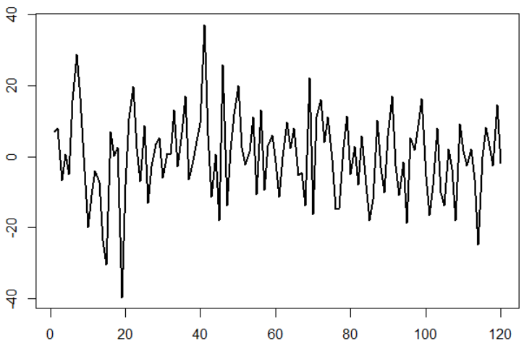
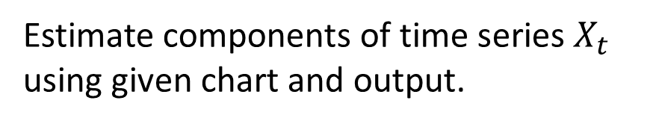

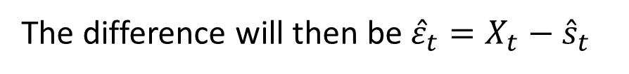
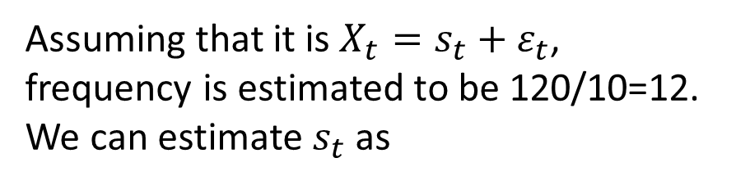
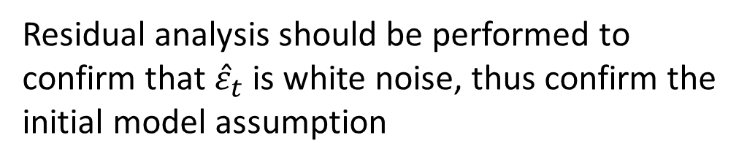
Example
Estimate components of time series $X_{t}$ using given chart and output.
Assuming that it is $X_{t}=s_{t}+ε_{t}$, frequency is estimated to be 120/10=12. We can estimate $s_{t}$as
$${\hat{s}}_{t}=\left(27, 19, 10, −1, −11, −10, −3, 4, 16, 30, 34, 43\right)$$
The difference will then be ${\hat{ε}}_{t}=X_{t}−{\hat{s}}_{t}$
$$\hat{σ}=12.03$$
Residual analysis should be performed to confirm that ${\hat{ε}}_{t}$is white noise, thus confirm the initial model assumption

Slide 8
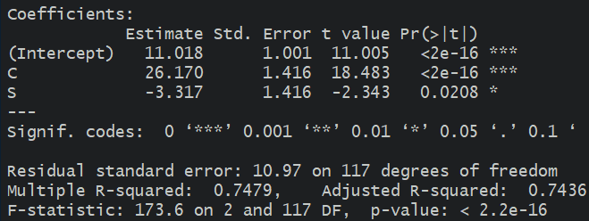

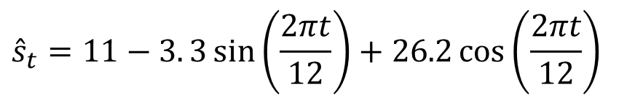
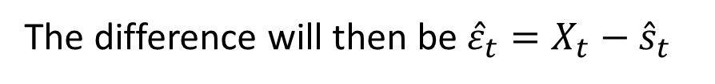
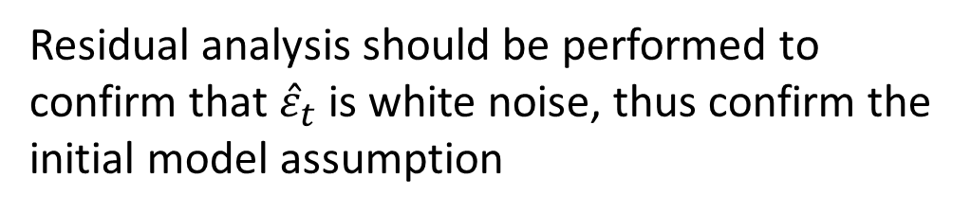
Example
Estimate components of time series $X_{t}$ using given chart and output.
Assuming that it is $X_{t}=s_{t}+ε_{t}$, frequency is estimated to be 120/10=12. We can estimate $s_{t}$as
$${\hat{s}}_{t}=11−3. 3\sin\left(\frac{2πt}{12}\right)+26.2\cos\left(\frac{2πt}{12}\right)$$
$$\hat{σ}=10.97$$
The difference will then be ${\hat{ε}}_{t}=X_{t}−{\hat{s}}_{t}$
Residual analysis should be performed to confirm that ${\hat{ε}}_{t}$is white noise, thus confirm the initial model assumption
Notes:
σ²

Slide 9

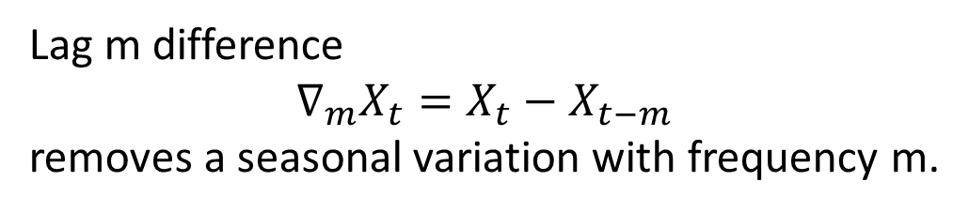





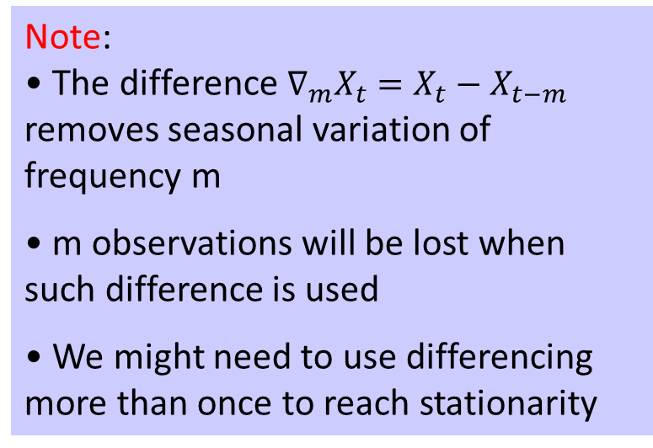

3. Differencing
Note:
• The difference $∇_{m}X_{t}=X_{t}−X_{t−m}$ removes seasonal variation of frequency m
• m observations will be lost when such difference is used
• We might need to use differencing more than once to reach stationarity
Lag m difference
$∇_{m}X_{t}=X_{t}−X_{t−m}$
removes a seasonal variation with frequency m.
That is, the time series after such difference will be white noise IF the initial model is only composed of seasonal variation and white noise.
$$X_{t}=s_{t}+ε_{t}$$
$$s_{t}=s_{t+m}$$
$$∇_{m}X_{t}=X_{t}−X_{t−m}$$
$=\left(s_{t}+ε_{t}\right)−\left(s_{t−m}+ε_{t−m}\right)$
$=\left(s_{t}−s_{t−m}\right)−\left(ε_{t}−ε_{t−m}\right)$
$$=0+\left(ε_{t}−ε_{t−m}\right)$$
$$=ε_{t}^{∗}$$
Notes:
After one difference, a quadratic trend will be reduced to a linear trend, after two differences the trend will be gone

Slide 10
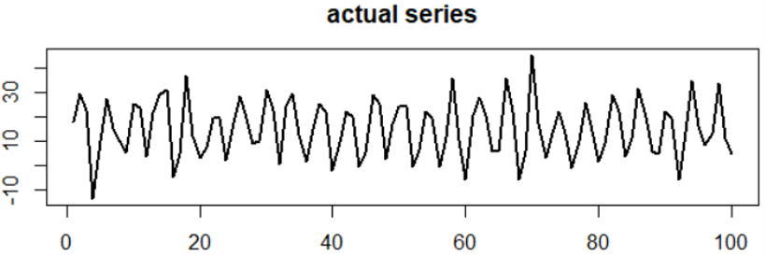
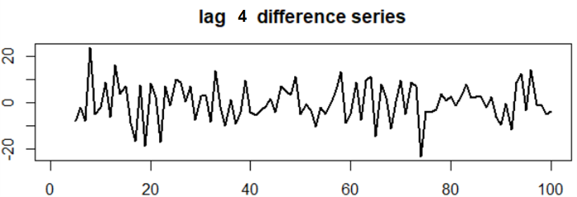
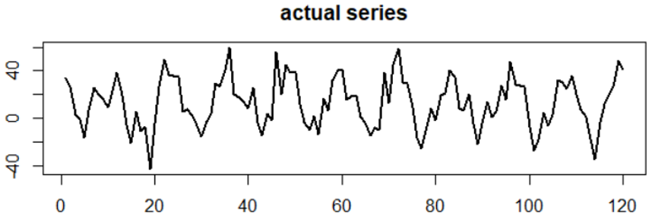
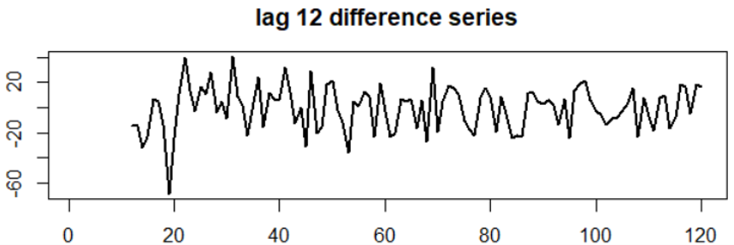
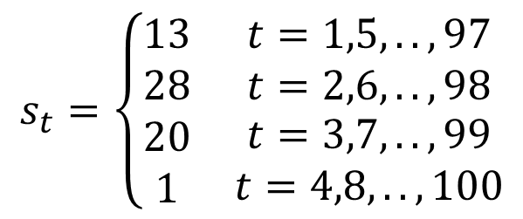

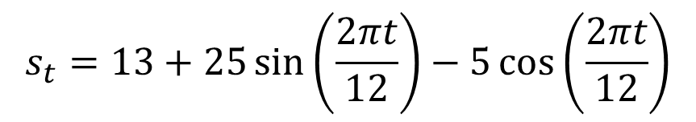






$$X_{t}=s_{t}+ε_{t}$$
$$t=1,2,…,100$$
$$ε_{t} \sim ^{i.i.d} N\left(0, 5\right)$$
$$s_{t}=\left\{\begin{matrix}13 & t=1,5,..,97 \\ 28 & t=2,6,..,98 \\ \begin{matrix}20 \\ 1\end{matrix} & \begin{matrix}t=3,7,..,99 \\ t=4,8,..,100\end{matrix}\end{matrix}\right.$$
$$s_{t}=s_{t+4}$$
$$X_{t}=s_{t}+ε_{t}$$
$$t=1,2,…,120$$
$$s_{t}=13+25\sin\left(\frac{2πt}{12}\right)−5\cos\left(\frac{2πt}{12}\right)$$
$$ε_{t} \sim ^{i.i.d} N\left(0, 12\right)$$
Notes:
In this example, a lag 4 difference has removed the seasonal variation, you can see that the data is now centered around 0, and is spread mostly between (-15,15)
In the second example, the lag 12 difference has removed the seasonal variation. You can see that we have lost some observation from the beginning of the series due to differencing.

Slide 11
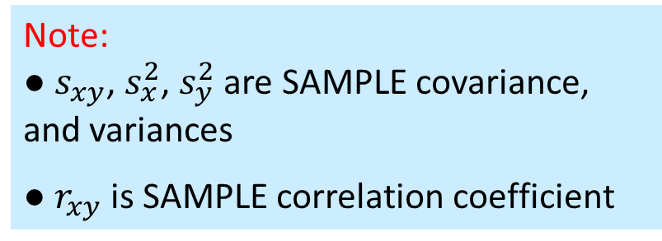
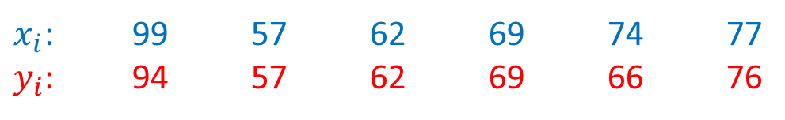
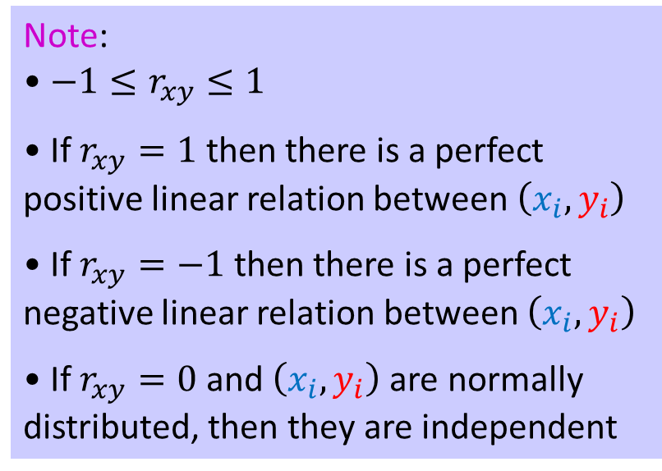

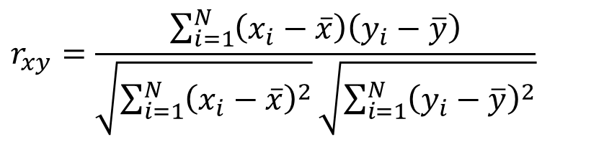

Correlation
Note:
• $−1≤r_{xy}≤1$
• If $r_{xy}=1$ then there is a perfect positive linear relation between $\left(x_{i},y_{i}\right)$
• If $r_{xy}=−1$ then there is a perfect negative linear relation between $\left(x_{i},y_{i}\right)$
• If $r_{xy}=0$ and $\left(x_{i},y_{i}\right)$ are normally distributed, then they are independent
Pearson correlation coefficient, is a common statistic that measures the direction and strength of linear association between two sets of data.
Given paired observations $\left(x_{i},y_{i}\right)$
$x_{i}$: 99 57 62 69 74 77
$y_{i}$: 94 57 62 69 66 76
Note:
● $s_{xy}$, $s_{x}^{2}$, $s_{y}^{2}$ are SAMPLE covariance, and variances
● $r_{xy}$ is SAMPLE correlation coefficient
it is computed as
$$r_{xy}=\frac{\sum_{i=1}^{N}{\left(x_{i}−\overline{x}\right)\left(y_{i}−\overline{y}\right)}}{\sqrt{\sum_{i=1}^{N}{{\left(x_{i}−\overline{x}\right)}^{2}}}\sqrt{\sum_{i=1}^{N}{{\left(y_{i}−\overline{y}\right)}^{2}}}}$$
$$=\frac{s_{xy}}{\sqrt{s_{x}^{2}}\sqrt{s_{y}^{2}}}$$

Slide 12

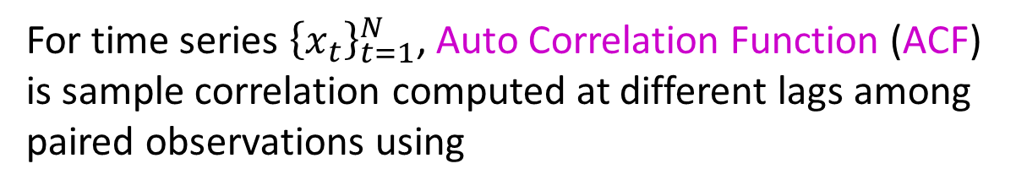
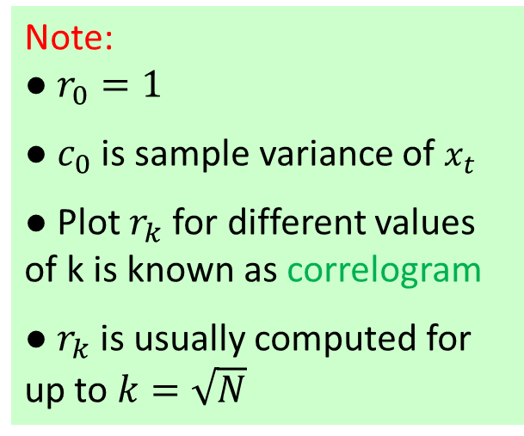


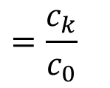


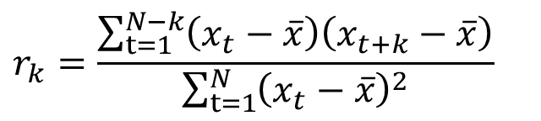

ACF
Note:
● $r_{0}=1$
● $c_{0}$ is sample variance of $x_{t}$
● Plot $r_{k}$for different values of k is known as correlogram
● $r_{k}$ is usually computed for up to $k=\sqrt{N}$
For time series ${\left\{x_{t}\right\}}_{t=1}^{N}$, Auto Correlation Function (ACF) is sample correlation computed at different lags among paired observations using
$$r_{k}=\frac{\sum_{t=1}^{N−k}{\left(x_{t}−\overline{x}\right)\left(x_{t+k}−\overline{x}\right)}}{\sum_{t=1}^{N}{{\left(x_{t}−\overline{x}\right)}^{2}}}$$
$$=\frac{c_{k}}{c_{0}}$$
$$k=0,1,2,…$$
For example
$x_{t}$: 22 26 24 28 29 27 31 32 33
$$r_{1}$$
$x_{t+1}$: 22 26 24 28 29 27 31 32 33
$$r_{2}$$
$x_{t+2}$: 22 26 24 28 29 27 31 32 33
$$⋮$$
$$r_{k}$$
$$x_{t+k}$$

Slide 13
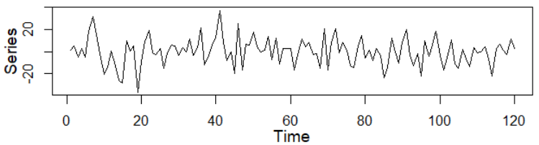
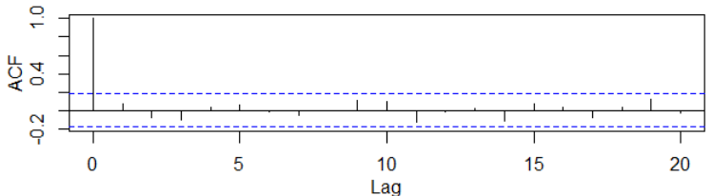
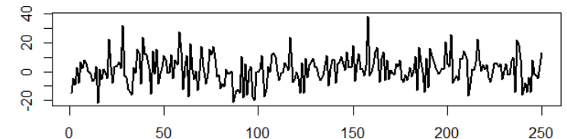
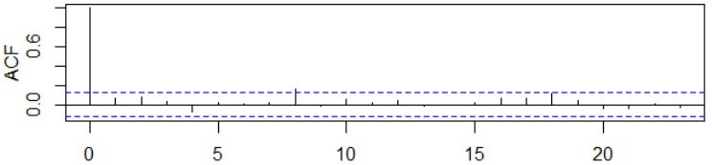
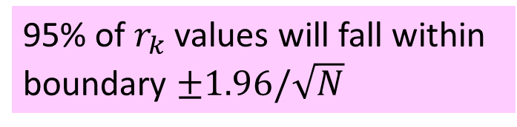

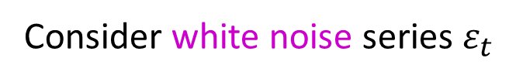
Example
Consider white noise series $ε_{t}$
The ACF for all white noise series will look like this:
$$r_{0}=1$$
95% of $r_{k}$values will fall within boundary $±1.96/\sqrt{N}$

Slide 14
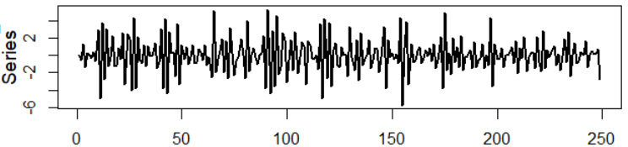
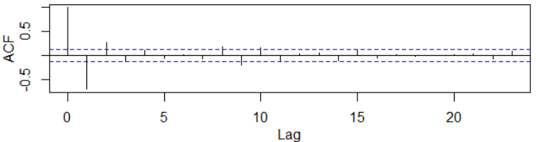
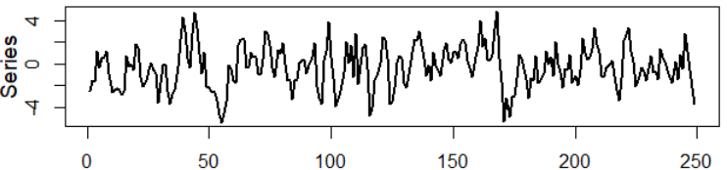



Stationary TS
Stationary time series exhibit short-term correlation characterized by a fairly large value of $r_{1}$ followed by one or two further coeﬃcients, which, while greater than zero, tend to get successively smaller.
Values of $r_{k}$ for longer lags tend to be approximately zero.
Notes:
In the first example, we have a stationary time series, the time plot is similar to plots of white noise, but this time series is not white noise. In the ACF plot, you see that $r_{1}$ is fairly large, around -0.6, value of $r_{2}$ drops to around 0.25, and expect for $r_{8}$ and $r_{9}$ all $r_{k}$ fall within the set boundary for white noise. Having 5% of the spikes outside the bounds but close to them is expected.
In the second example, ACF plot starts with $r_{1}$, so we have skipped $r_{o}$ to have a closer look at smaller values of $r_{k}$. You can see that $r_{1}$ is about 0.6, and $r_{2}$ drops to about 0.25. Rest of $r_{k}$ values are within the 95% boundary for white noise

Slide 15







Nonstationary TS
This is an example of a nonstationary timeseries that has a trend
$$x_{t}=μ_{t}+ε_{t}$$
For nonstationary time series the values of $r_{k}$ will not come down to zero except for very large values of k.
This is an example of a nonstationary timeseries that has seasonality
$$x_{t}=s_{t}+ε_{t}$$
Notes:
For nonstationary time series, values of $r_{k}$ will not come down to zero except for very large values of k
In here on top we have a time series that has trend. Looking at the ACF plot, values of $r_{k}$ slowly decrease, and are outside the boundary for white noise even when k is equal to 23, which is a large value for lags.
The second plot shows a time series that has seasonal variation. You can see that there is a periodic pattern in the ACF function, $r_{k}$ values decrease slowly but fall outside the boundary for white noise in a cyclic pattern. This cyclic pattern is an indicator of existing seasonal variation

Slide 16

Practice Problems
1. Load “sims.csv” data into your session and answer the following questions for simulated time series $x_{9t}$.
a. Graph a time plot and describe the existing seasonal variation.
b. Estimate the frequency then the seasonal variation using a method that seems right in this case.
c. Perform moving average of window 15 and graph the results along the actual series, then comment.
d. Achieve stationarity through differencing. Graph the final time series and comment.
e. Given results from a-d estimate all the components of this time series and write it down.
2. Repeat the same steps for $x_{10t}$in “sims.csv” dataset.

Slide 17


Practice Problems
3. Generate ACF plot of $x_{10t}$ from sims.csv dataset in results of steps a-d and interpret the outcome.
4. Repeat practice problem 3 for $x_{7t}$ data. Parts a-d are described in W2 practice problems.

